Slide 1
CMSC 207
Discrete Structures
Lecture 08
© Vadim Bulitko : CMPUT 272, Winter 2004, UofA

Slide 2
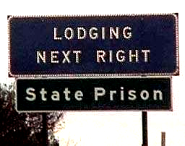

Today
Chapter 3.3
  Divisibility
Chapter 3.4
  Quotient-remainder theorem
All images are copyrighted to their respective copyright holders and reproduced here for academic purposes under the condition of “fair using”.
Lecture 08
© Vadim Bulitko : CMPUT 272, Winter 2004, UofA

Slide 3

Rational / Irrational
For more information see:
  http://mathworld.wolfram.com/
  http://mathworld.wolfram.com/IrrationalNumber.html
  http://mathworld.wolfram.com/Pi.html
  http://mathworld.wolfram.com/e.html
Lecture 08
© Vadim Bulitko : CMPUT 272, Winter 2004, UofA

Slide 4
Divisibility
Integers n, d; d≠0
  d (wholly) divides n
  d is a divisor of n
  d is a factor of n
  n is a multiple of d
  n is divisible by d
  d | n
iff:
  ∃k∈Z [ n=dk ]
Lecture 08
© Vadim Bulitko : CMPUT 272, Winter 2004, UofA

Slide 5
Positive Divisors
If a|b and a,b>0 then a≤b
  prove
prime(n) iff (n>1 & n’s only positive divisors are 1 and n)
  prove
Lecture 08
© Vadim Bulitko : CMPUT 272, Winter 2004, UofA

Slide 6
Properties
Transitivity:
  a|b, b|c → a|c
Reflexivity:
  a|a
Anti-symmetry (for naturals):
  a|b & b|a → a=b
  Let’s prove this
Lecture 08
© Vadim Bulitko : CMPUT 272, Winter 2004, UofA

Slide 7
Quotient-remainder Theorem
For any integer n
For any integer d>0
There exist unique integers q and r
Such that
  n=dq+r
  0≤r<d
q is the quotient : q=n div d
r is the remainder : r=n mod d
Lecture 08
© Vadim Bulitko : CMPUT 272, Winter 2004, UofA

Slide 8
Proof
Section 4.4 of the text
We will (hopefully) do it later in class
Lecture 08
© Vadim Bulitko : CMPUT 272, Winter 2004, UofA

Slide 9
Connection to odd/even
Suppose d=2, then 0 ≤ r < 2
Then for any integer n:
  r=0 → n=2q → n is even
  r=1 → n=2q+1 → n is odd
So every number is odd or integer
Lecture 08
© Vadim Bulitko : CMPUT 272, Winter 2004, UofA

Slide 10
Factors
Recall that if x|a and a>0,x>0 then x≤a
Consider set F(a)={x∈Z s.t. x|a}
∀x∈F(a) [ x≤a ]
So F(a) is upper bounded thus has a maximum element (by the well-ordering principle)
Call max F(a) highest factor
Lecture 08
© Vadim Bulitko : CMPUT 272, Winter 2004, UofA

Slide 11
Highest Common Factor
Consider integers a>0, b>0
Consider set F(a,b)={x∈Z s.t. x|a & x|b}
∀x∈F(a,b) [ x≤a & x≤b ]
So F(a,b) is upper bounded thus has a maximum element (by the well-ordering principle)
Call max F(a,b) highest common factor:
  hcf(a,b)
Lecture 08
© Vadim Bulitko : CMPUT 272, Winter 2004, UofA

Slide 12
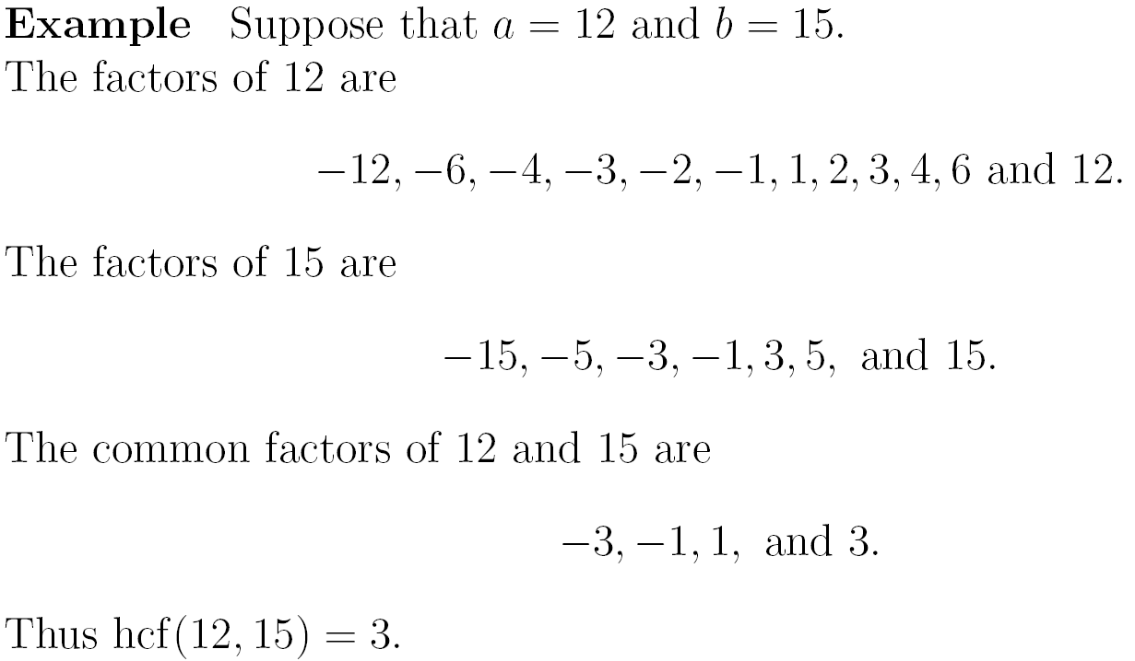
Example
Lecture 08
© Vadim Bulitko : CMPUT 272, Winter 2004, UofA

Slide 13


Euclid’s Algorithm Idea
Works fine for small numbers
What about hcf(4453,1314) ?
Here is an idea:
Lemma. a>b, a=qb+r then hcf(a,b)=hcf(b,r)
Proof.
  Consider F(a,b)={x st x|a & x|b}
  Consider F(b,r)={x st x|r & x|b}
  If x₁∈F(b,r) then x₁|a, thus x₁∈F(a,b)
  If x₂∈F(a,b) then x₂|r, thus x₂∈F(b,r)
Lecture 08
© Vadim Bulitko : CMPUT 272, Winter 2004, UofA

Slide 14
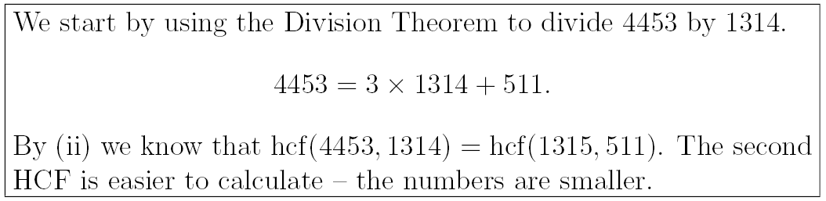
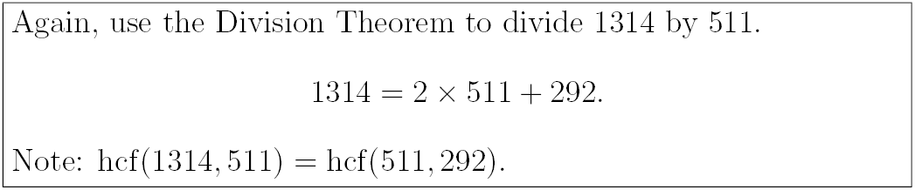
Euclid’s Algorithm
Lecture 08
© Vadim Bulitko : CMPUT 272, Winter 2004, UofA

Slide 15
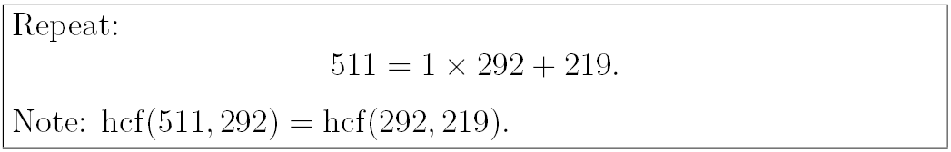
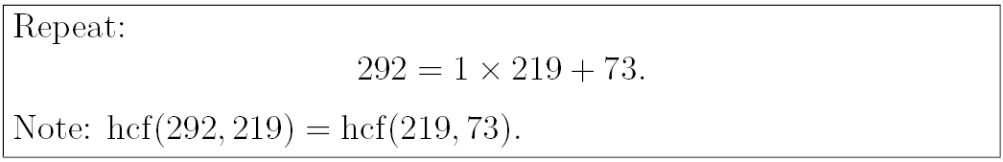
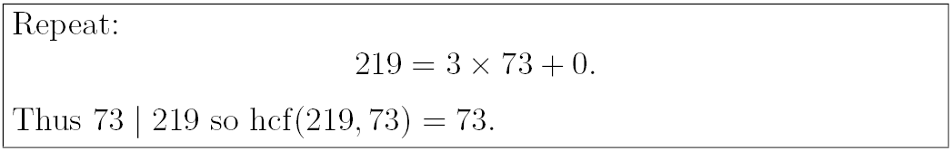

Euclid’s Algorithm
Lecture 08
© Vadim Bulitko : CMPUT 272, Winter 2004, UofA

Slide 16
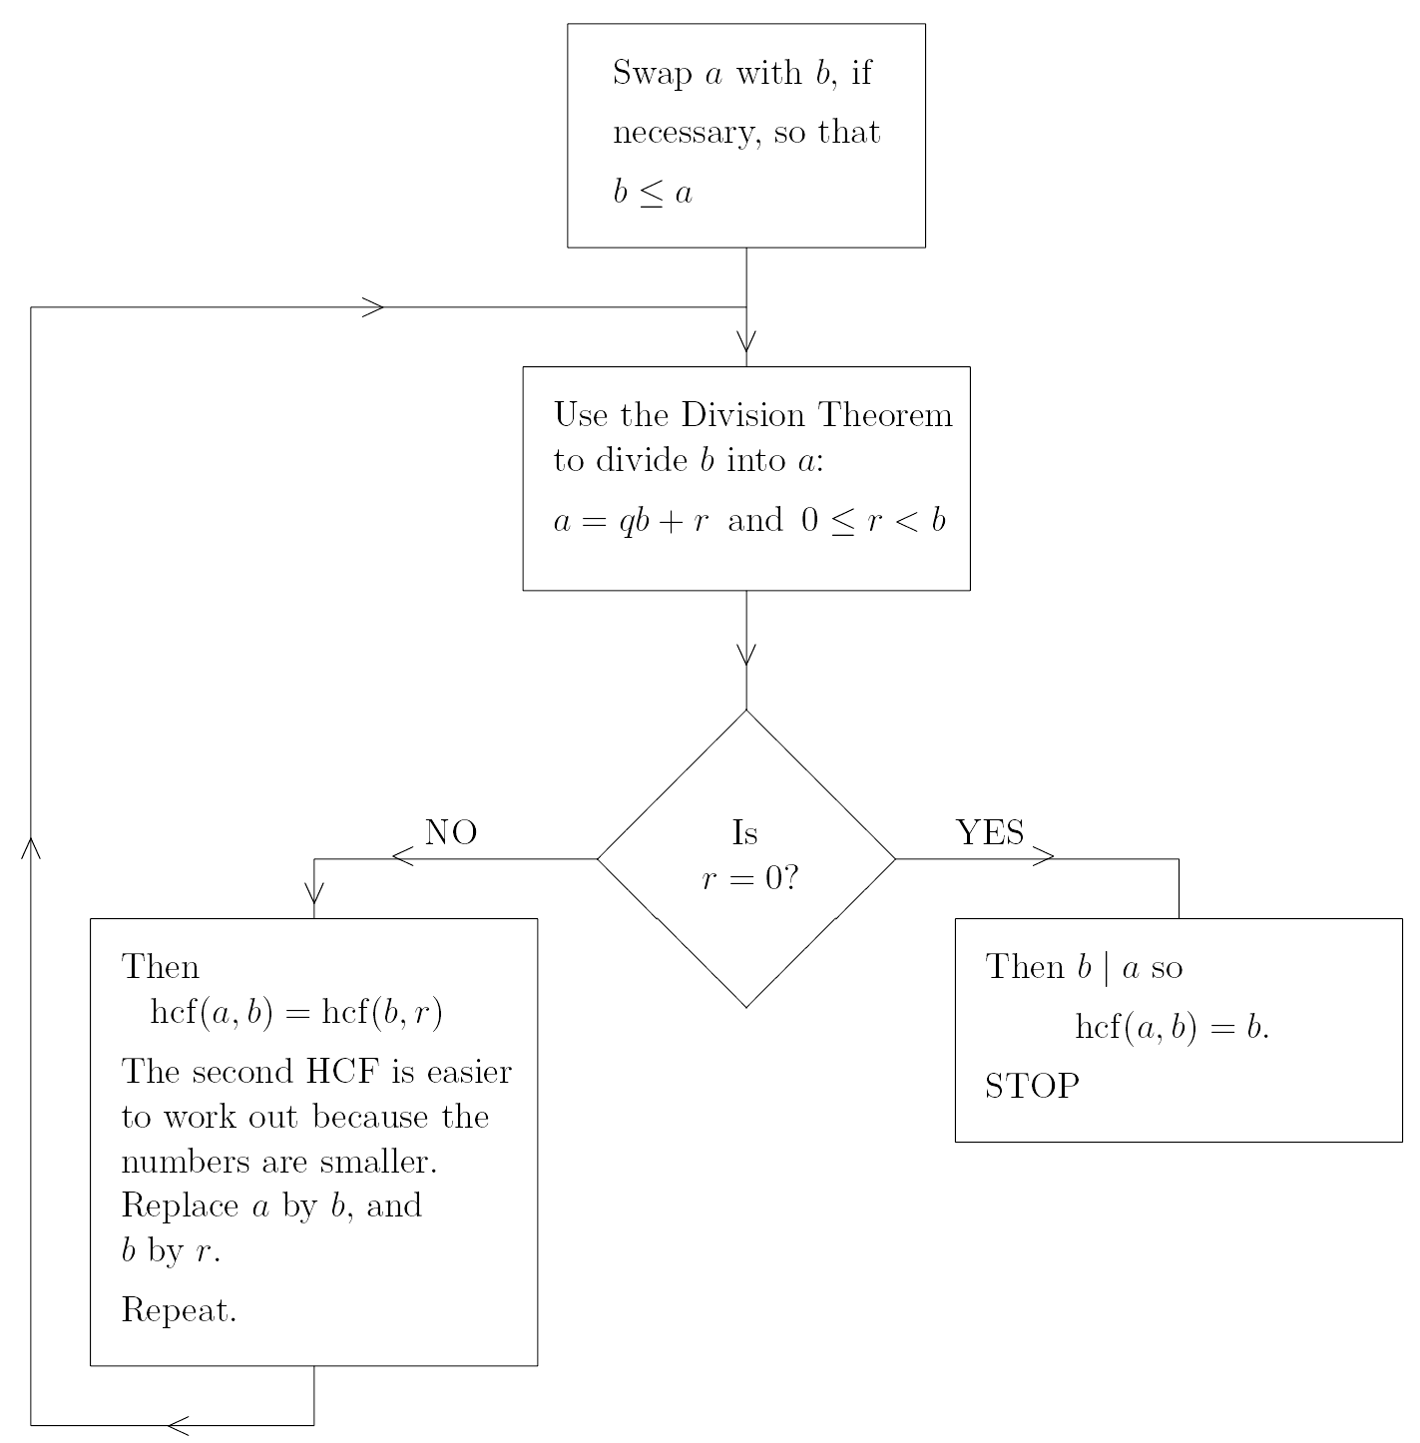
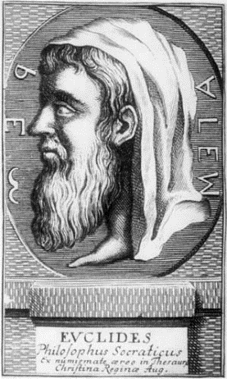
Flow Chart
Lecture 08
© Vadim Bulitko : CMPUT 272, Winter 2004, UofA

Slide 17
Correctness
The algorithm is correct:
  For any valid inputs
  It terminates in a finite amount of time
  And produces a correct output
Challenge:
  Prove this at home
  Must be your original proof
Lecture 08
© Vadim Bulitko : CMPUT 272, Winter 2004, UofA

Slide 18
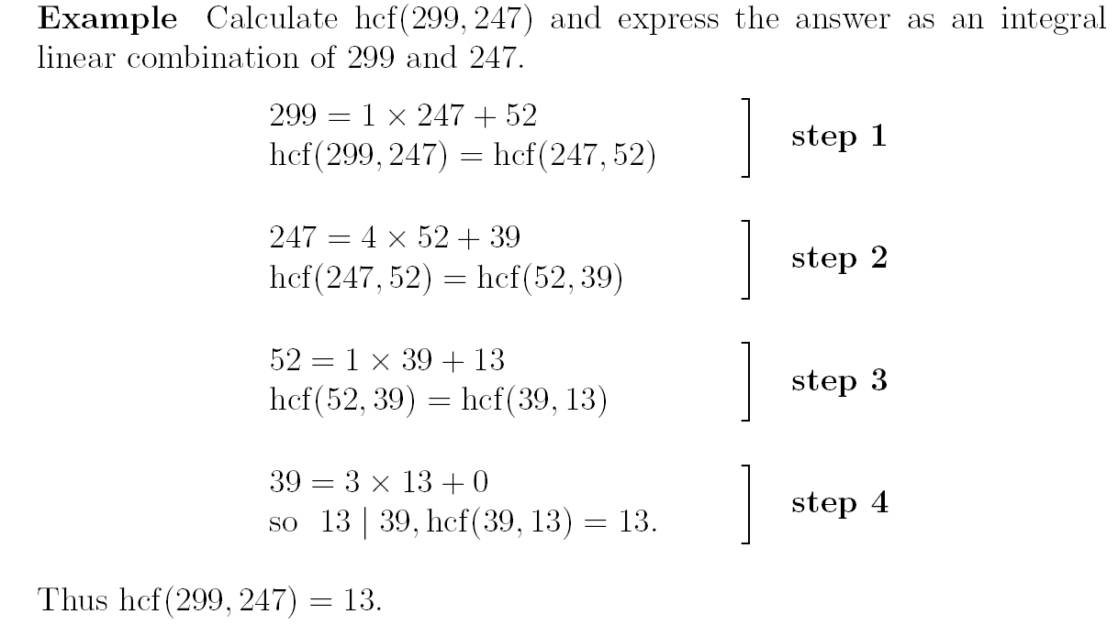
Another Example
Lecture 08
© Vadim Bulitko : CMPUT 272, Winter 2004, UofA

Slide 19
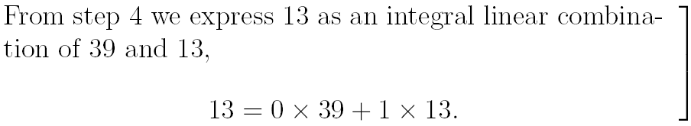
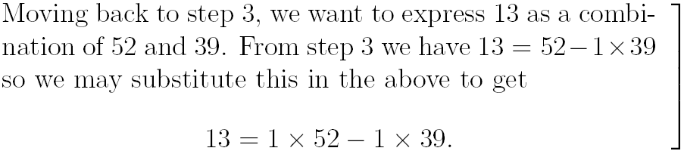
Going Back
Lecture 08
© Vadim Bulitko : CMPUT 272, Winter 2004, UofA

Slide 20
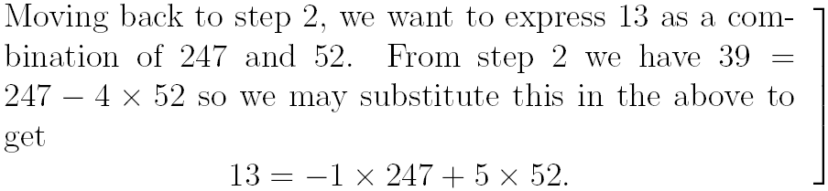
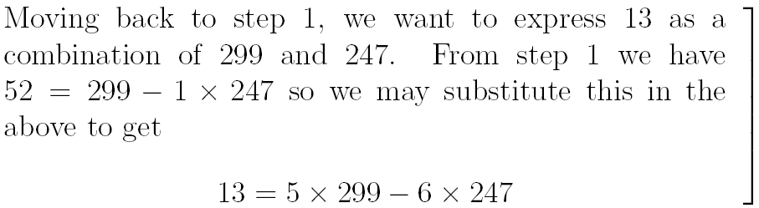
Going Back
Lecture 08
© Vadim Bulitko : CMPUT 272, Winter 2004, UofA

Slide 21
Corollary
For any integer p,q (one of them is not 0)
If
  h=hcf(p,q)
then
  there exist integers x,y s.t. xp+qy=h
Lecture 08
© Vadim Bulitko : CMPUT 272, Winter 2004, UofA

Slide 22
Factoring
Finding divisors (factors) of a number is called factoring
A straightforward by expensive operation (recall the RSA challenges)
Consider 24:
  24=1*24
  24=(-1)*(-24)
  24=(-1)*4*2*(-3)
  …
Is there a “canonical” representation?
Lecture 08
© Vadim Bulitko : CMPUT 272, Winter 2004, UofA

Slide 23
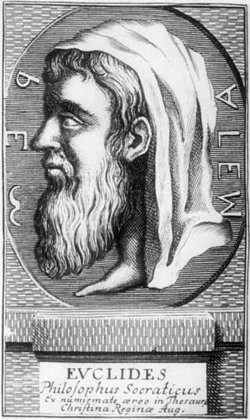
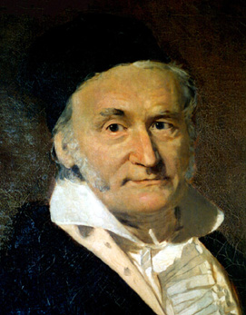
Fundamental Theorem Of Arithmetic
Any integer z≠0 can be represented as:
  z = (-1)^{k} p₁^{k1} p₂^{k2} … p_{n}^{kn}
where:
  p₁<…<p_{n} are prime numbers
  k is 0 or 1
  k₁,…,k_{n} are natural >0
This factorization is unique
Examples:
  24=(-1)⁰ 2³ 3¹
  -7=(-1)¹ 7¹
Lecture 08
© Vadim Bulitko : CMPUT 272, Winter 2004, UofA

Slide 24
Proof (existence)
Let’s prove that for any n∈Z, n>0 such a representation exists
Steps:
  Lemma 0. There are n integers between 1 and n
  Lemma 1. Non-trivial factors of a natural n are strictly less than n
  Lemma 2. Every integer n>1 is divisible by a prime number
  Corollary: can get exclusively prime factors for n>1
Lecture 08
© Vadim Bulitko : CMPUT 272, Winter 2004, UofA

Slide 25

Proof (uniqueness)
Let’s prove that such representation is unique
Steps:
  Lemma 3. If h=hcf(p,q) then there exist integers x,y s.t. xp+qy=h
  Lemma 4 (E1stT). If p|ab and prime(p) then p|a or p|b
  Proof:
    Suppose not. Then two different factorizations exist
    Then arrive at a contradiction
Lecture 08
© Vadim Bulitko : CMPUT 272, Winter 2004, UofA

Slide 26
Further Information
Lecture notes (we reproduced some parts from):
  http://www.mat.bham.ac.uk/P.J.Flavell/teaching/Foundation/LectureNotes/
Some background:
  http://mathworld.wolfram.com/EuclidsTheorems.html
How to discover the proof:
  http://www.dpmms.cam.ac.uk/~wtg10/FTA.html
Lecture 08
© Vadim Bulitko : CMPUT 272, Winter 2004, UofA

